Slide 1
The State Personal Data Protection Agency Under the Cabinet of ministers of the Kyrgyz Republic
The State Personal Data Protection Agency
2022 YEAR
Кыргызской Республике
2022 год

Slide 2
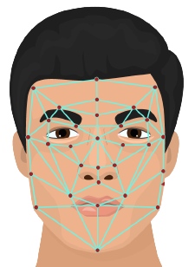
WHAT IS PERSONAL DATA?
Personal Data

Slide 3
PERSONAL DATA
PIN
FULL NAME
Personal number
Fingerprint
Retina of the eye
Vein pattern
Facial biometrics
Cookies
Unique login
Handwriting / signature
Electronic signature
Genetics / DNA
Financial transactions
Relatives
Passwords
Criminal record
Nationality
Date, place of birth
Knowledge
Habits
Life events
Education
Financial situation
Beliefs

Slide 4
SPECIALLY PROTECTED PERSONAL DATA
race and nationality
political views
religion
sexual orientation
biometric data — physical, physiological or behavioral characteristics of an individual, with the help of which it is possible to uniquely identify a person. For example, an image of a human face, fingerprints, retinas, voice recording, etc.
health data – data about a person's physical or mental health. For example, medical tests and conclusions.
genetic data – inherited or acquired genetic characteristics of an individual that provide unique information about physiology or health, as well as relevant biological samples

Slide 5
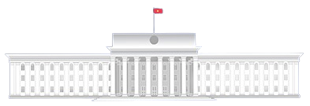
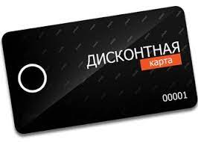
EXAMPLES OF PERSONAL DATA COLLECTION
ELECTRONIC WALLETS
Schools
STATE AND MUNICIPAL BODIES
DISCOUNT CARDS
Internet-BANKING
MARKETING

Slide 6
State agencies and local self-government bodies - holders of data arrays
The holder (holder) of an array of personal data has temporary rights to process personal information with the personal consent of a citizen
A citizen is the only legal owner of personal data

Slide 7
What do government agencies know about citizens?
- INN - biometric data - passport data - real estate- vehicles - social and tax deductions - according to the officials of the management staff - the contents of bank accounts - the presence / absence of a criminal record - medical tests - AIDS/HIV/tuberculosis - Full name of children studying at school; - affiliation (through registration of legal entities) - family ties (autobiography)

Slide 8
What do commercial organizations know about citizens?
- INN; - passport data; - address; - geolocation; - purchase and payment history (stores, pharmacies); - food preferences; - bank card details; - medical tests; - history of visiting web resources; - solvency or availability of property (collateral in banks or universities); - travel history

Slide 9
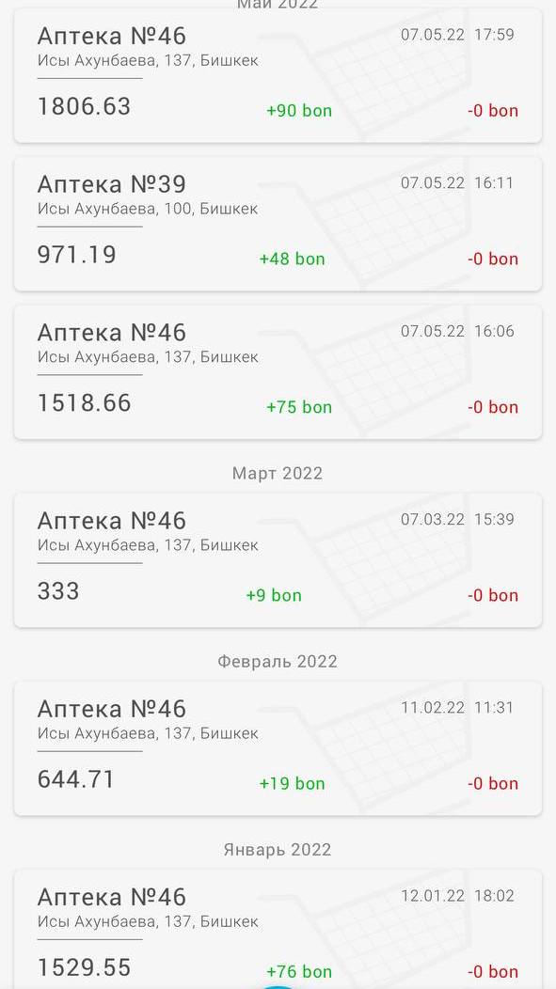
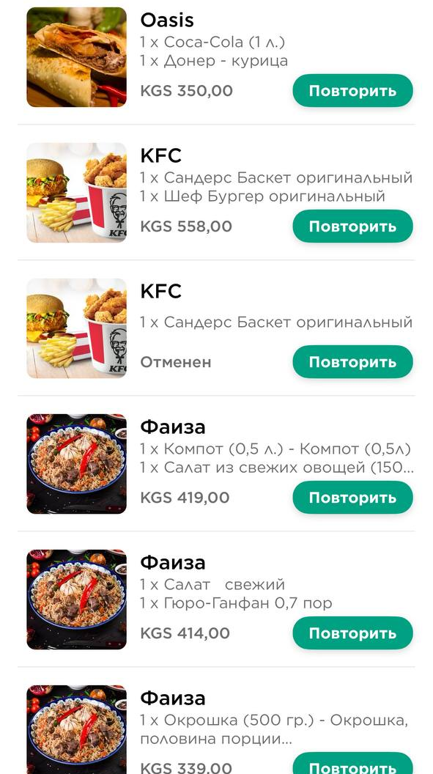

Slide 10
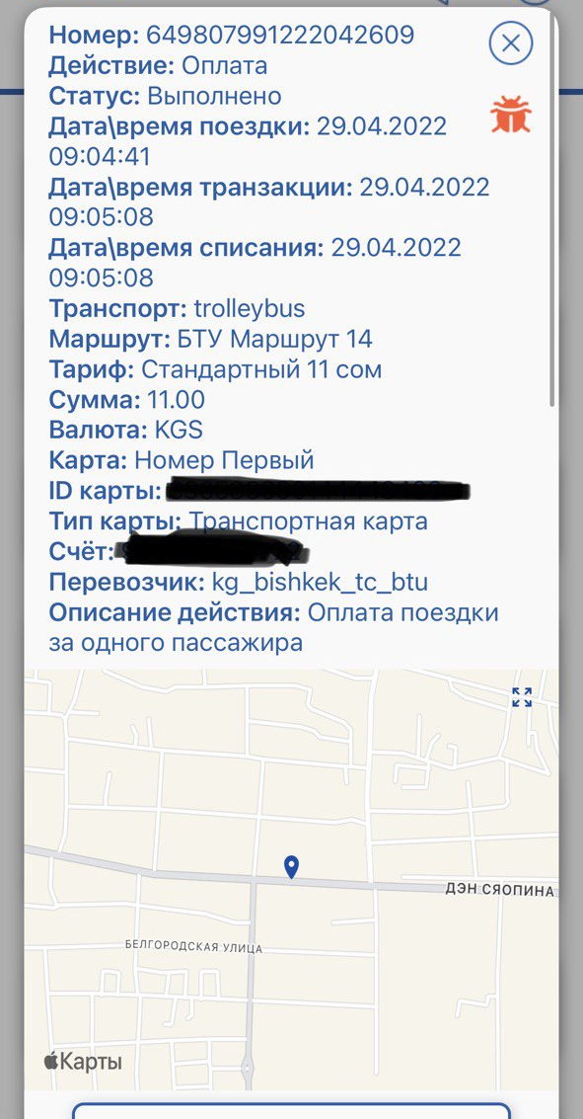
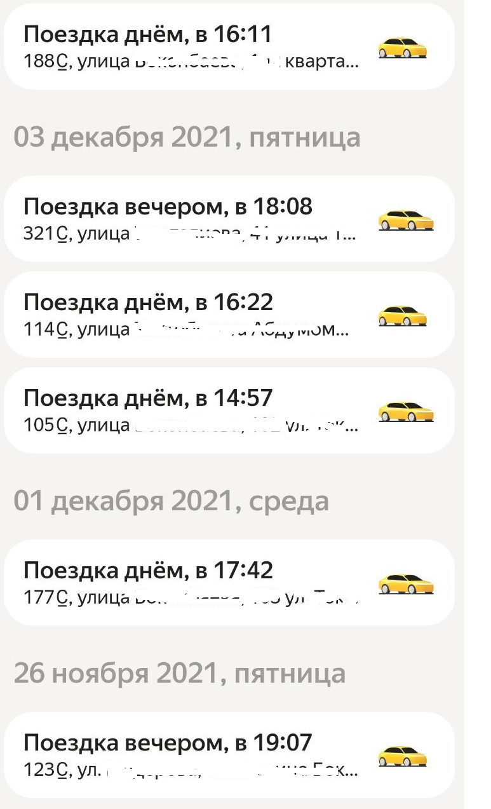

Slide 11
Effects
Identity theft is a serious threat to victims of data breaches. Data leaks can reveal everything from social security numbers to banking information. As soon as the criminal receives this data, he can participate in all types of fraud.
Notes:
Ущерб, который может нанести утечка данных
Для коммерческих организаций: утечка данных может иметь разрушительные последствия для репутации организации и финансовых результатов. Многие организации (например, Equifax, Target и Yahoo) стали жертвами утечки данных. И сегодня многие люди ассоциируют/помнят эти компании с самим инцидентом с утечкой данных, а не с их фактическими бизнес-операциями.
Для государственных организаций: скомпрометированные данные могут означать передачу строго конфиденциальной информации иностранным лицам. Военные операции, политические сделки и детали, касающиеся важнейшей национальной инфраструктуры, могут представлять серьезную угрозу для правительства и его граждан.
Для физических лиц: кража личных данных является серьезной угрозой для жертв утечки данных. Утечки данных могут раскрыть все, от номеров социального страхования до банковской информации. Как только преступник получит эти данные, он сможет участвовать во всех видах мошенничества под вашим именем. Кража вашей личности может дискредитировать вас, и даже если вы будете действовать законно, вернуться назад будет трудно.

Slide 12
What has been done and plans?

Slide 13
Statistics

Slide 14
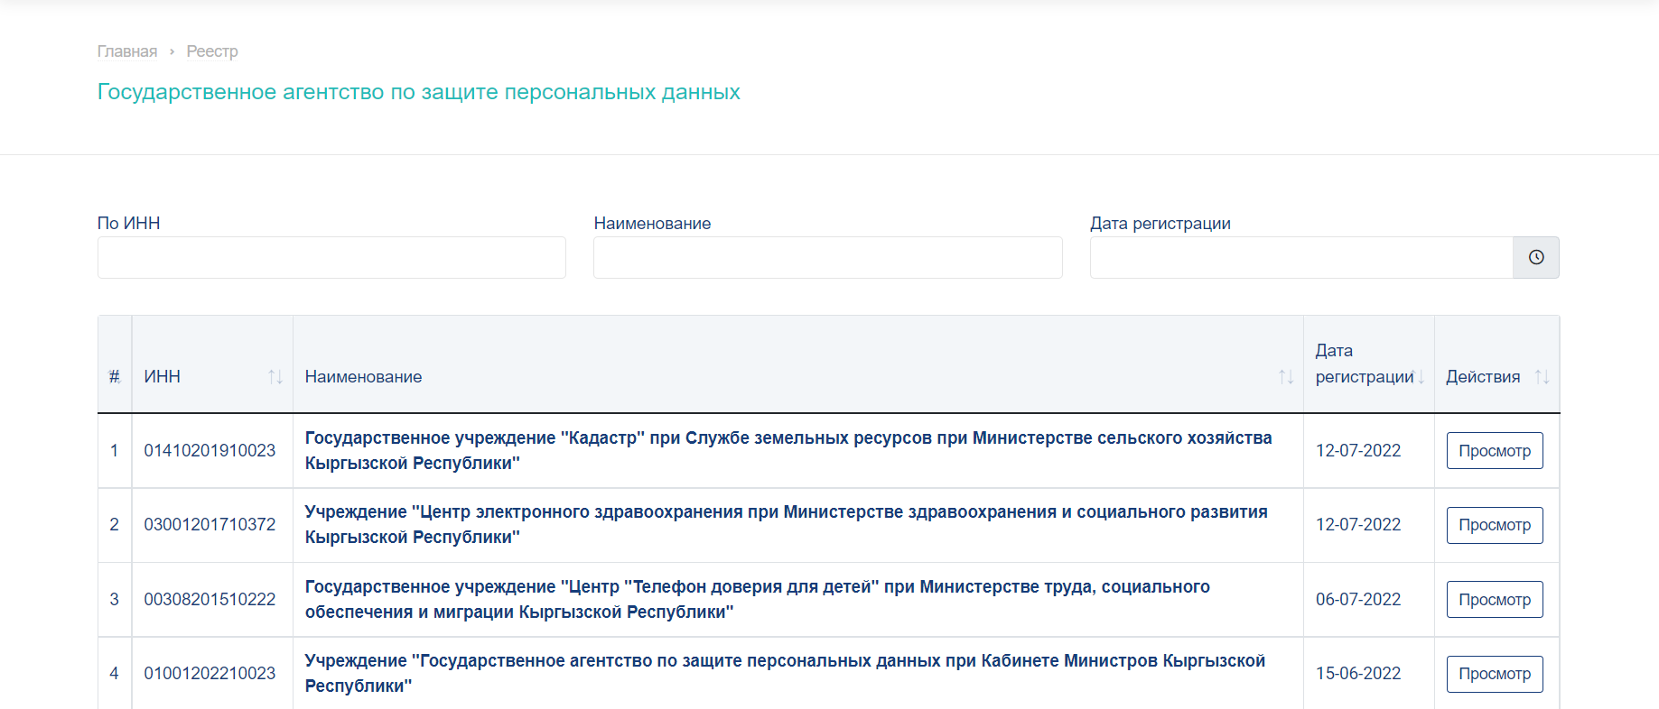
WHO COLLECTS PERSONAL DATA? REGISTER OF HOLDERS (OWNERS) OF PERSONAL DATA ARRAYS

Slide 15
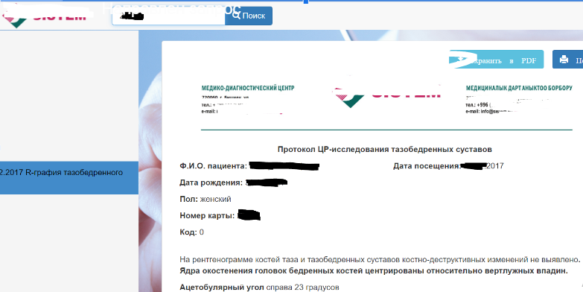
In the medical clinic "S." - medical analyses of patients are displayed in an open form.
2 requests have been sent

Slide 16
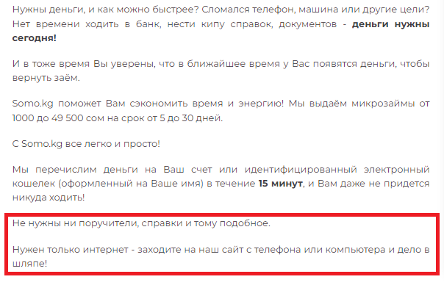
In April 2022, in Tokmok, a prisoner through the mobile application "S.KG" took out a loan using someone else's personal data.
Working with the Ministry of Internal Affairs.

Slide 17
Who is the holder?
Holder (owner) of an array of personal data - state authorities, local self-government bodies and legal entities that are authorized to determine the purposes, categories of personal data and control the collection, storage, processing and use of personal data in accordance with this Law.
Part 2 of Article 16 of the Law "On Personal Information“
Legal entities have the right to work with personal data after registration with an authorized state body as a holder (holder) of an array of personal data in accordance with Article 30 of this Law.

Slide 18
Handler
The processor is a natural or legal person, determined by the holder (owner) of personal data, who processes personal data on the basis of a contract concluded with him.

Slide 19
Our contacts:
Address: Bishkek city, Chui Avenue, 265a (National Academy of Sciences of the Kyrgyz Republic, second floor, west wing)
Telephone: +312 64 10 14, +(996) 990 950 850
Website: https://dpa.gov.r
Email: info@dpa.gov.kg

Slide 20
Follow us on social media
Facebook and Instagram: dpa.gov.kg
Telegram: @dpagovkg
Telegram bot: @AgentstvoPDbot

Slide 21
Thanks for your attention!
info@dpa.gov.kg

